Slide 1
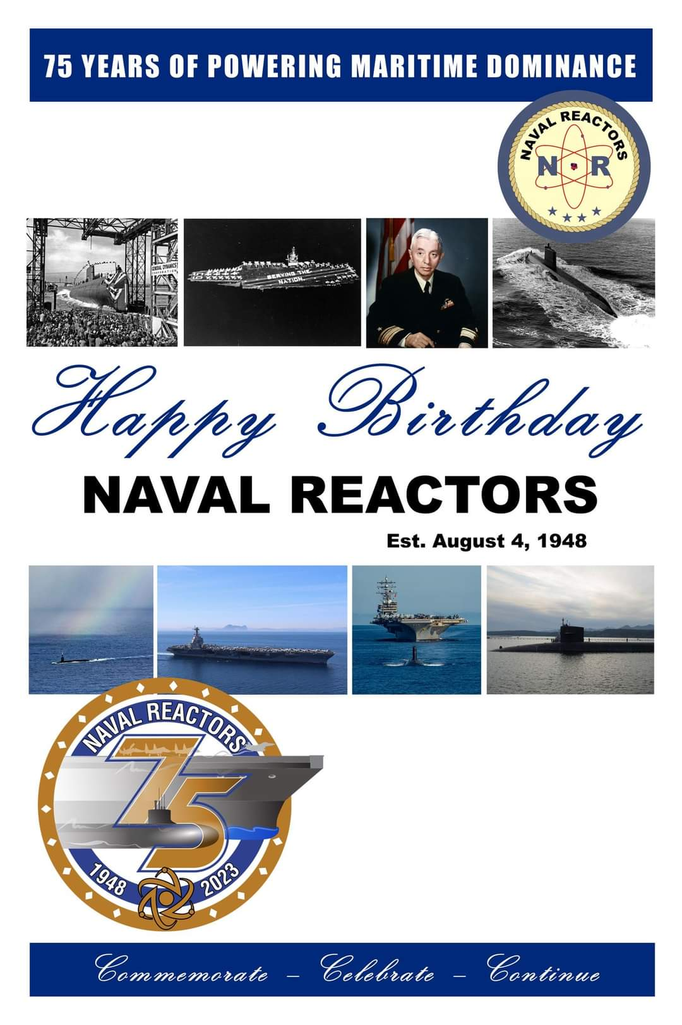
Happy 75th Birthday, Naval Reactors!
Joint Department of the Navy and Department of Energy organization
All aspects of Navy nuclear propulsion
Research
Design
Construction
Testing
Operation
Maintenance
Notes:
August 4, 1948. Joint organization between the Department of the Navy and Department of Energy, and formerly Atomic Energy Commission.
Robert Downey, Jr., portrayed Lewis Strauss who was the AEC chair from 1953-1958.
Rickover (USNA ‘22) was the head of Naval Reactors until 1982. It is currently ADM James Caldwell (USNA ’81).

Slide 2
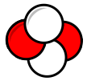
Warm Up
Can you name the 4 types of ionizing radiation? (sufficient energy to ionize atoms or molecules)
Alpha (α) – A helium nucleus
2 protons, 2 neutrons
Charge +2e
Beta (β) – An electron (β–) or positron (β⁺) from the nucleus
Gamma (γ) – High energy (frequency) photon > 2.4 X 10¹⁵Hz
Neutron (n) – Ionizing H atoms and neutron capture
Notes:
“Activating prior knowledge” or at a minimum, putting the students into a learning mode by stimulating thought and hopefully tapping into their curiosity.

Slide 3
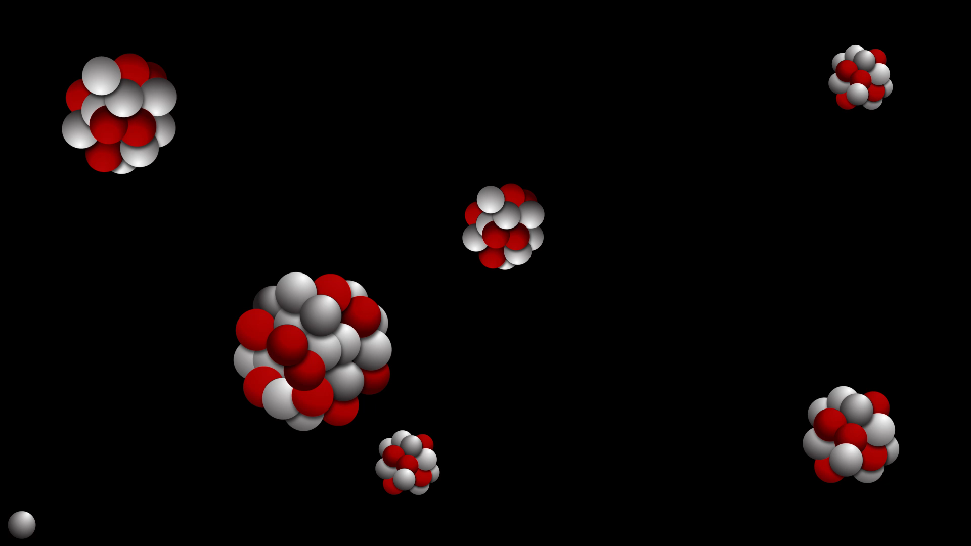
Nuclear Fission
Doug Nekrasz
AtomicArchive.com

Slide 4
Agenda
Warm Up
Objectives
Greek Letter Alerts!
The History
Binding Energy and Mass Defect
The Power of Fission
Mechanism
Review Objectives
Questions and Assessment

Slide 5
Objectives
Define the following terms:
Fission – Fissile – Mass defect – Binding energy
Criticality – Critical mass – Moderator
Discuss the history of some key events leading to the fission of U-235
Describe the mechanism of U-235 fission
Contrast fast and thermal neutrons and the role of the moderator
Discuss the effect of decay heat on reactor power and temperature

Slide 6
Notes:
For the sake of brevity, I am quickly showing what I normally do for my high school students who need to become familiar with Greek letters. For this lesson, alpha, beta and gamma apply. Delta is introduced in one of the first lessons of the new school year.

Slide 7
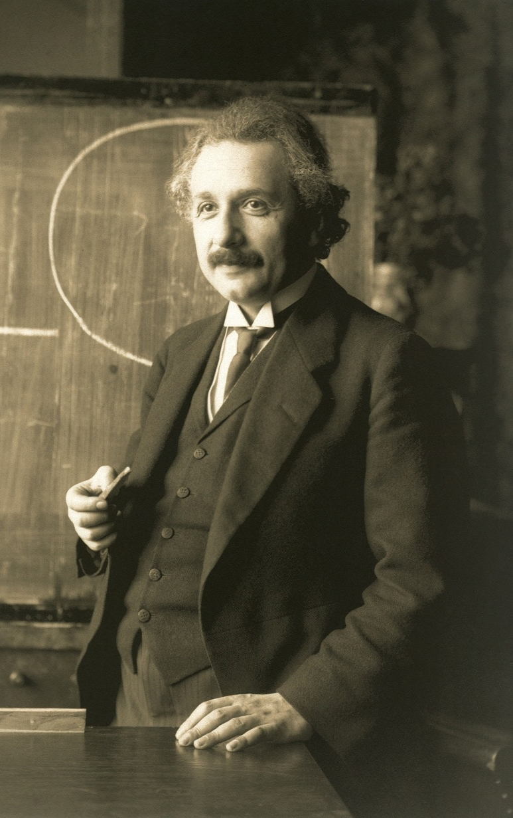
The History
Albert Einstein (1879-1955)
German-born theoretical physicist
Swiss Patent Office
Special relativity (1905)
General relativity (1915)
1921 Nobel Prize in Physics
“The letter”
Wikipedia
Notes:
Considered one of the greatest minds of all time, he is best known for theory of relativity. Born in Ulm, Kingdom of Wurttemberg, German Empire, he moved to Switzerland in 1895, forsaking his German (Kingdom of Wurttemberg) citizenship. After graduation from college in Zurich, he obtained Swiss citizenship, started working in the Swiss Patent Office and was awarded a PhD from the University of Zurich in 1905.
1905 is known as his “annis mirablis,” or his “remarkable year,” when he published, in addition to his doctoral thesis, 4 groundbreaking papers describing special relativity, explaining the behavior of electromagnet fields that contradict what is now called “classical mechanics.” It is the fourth paper where he concludes that if this is true, then mass and energy are equivalent: The famous E=mc².
He eventually ended up back in Germany, this time the Kingdom of and then Free State of Prussia in 1914.
While visiting the U.S. in 1933, the new regime in Germany took hold. His cottage was raided, his boat seized, and many of his published works burned. This lead to him renouncing his German citizenship and eventually heading back to America.
In 1939, a group of Hungarian émigré physicists attempted to alert the U.S. government of Germany’s attempt to use the latest atomic research to build weapons. Unsuccessful, the scientists, who included Leo Szilard and Edward Teller, convinced Einstein to sign a letter to President Roosevelt, eventually leading to the start of the Manhattan Project.
Later, he said to his friend Linus Pauling that signing the letter was a mistake, but did acknowledge there was real danger in Germany succeeding in creating nuclear bombs.
Toward the end of his life, he contemplated the randomness of quantum mechanics, refusing to accept this, saying “God does not play dice.” He also attempted to reconcile gravity and electromagnetism with a unified field theory, that still is vexing scientists today.

Slide 8
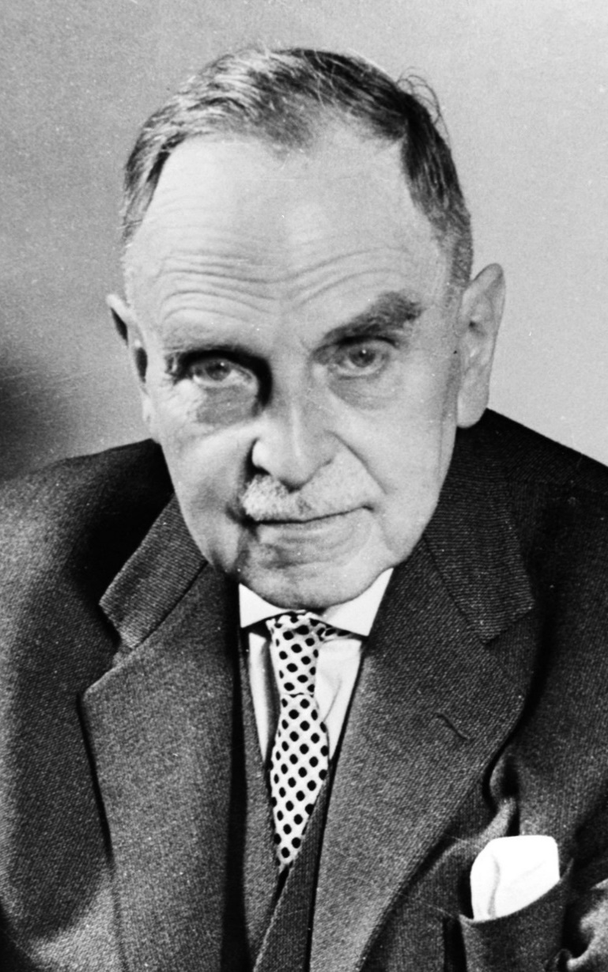
The History
Otto Hahn (1879-1968)
German chemist
WWI vet
Studied isotopes via neutron bombardment of uranium and thorium
“The father of nuclear fission”
1944 Nobel Prize for Chemistry
Wikipedia
Notes:
Awarded a PhD by the University of Marburg in 1901, Hahn studied under Sir William Ramsay at the University College London and Ernest Rutherford at McGill University in Montreal, where he discovered several new radioactive isotopes. He returned to Germany in 1906 and started working at what eventually became the Max Planck Institute where his discoveries of radioisotopes were considered unimportant by other chemists. So he started to work with Austrian physicist Lise Meitner and Fritz Strassmann, physicists more appreciative of his work. Hahn and Meitner worked closely for 30 years and remained life-long friends.
During WWI, Hahn worked with German chemist Fritz Haber on their gas warfare effort.
After the war, the group continued their studies of isotopes, bombarding uranium and thorium with neutrons, leading to the discovery of the actinide series of elements and eventually fission.
For this, he was awarded the 1944 Nobel Prize in Chemistry for the discovery of the fission of heavy atomic nuclei.
He was against the Nazis and their persecution of Jews, which resulted in many of his colleagues being removed from their academic posts, including Meitner. However, his work on the German atomic bomb effort resulted in him being detained by the Allies for a time after WWII. Eventually released, he became head of the Max Planck Institute and worked tirelessly to rebuild the German scientific community. Hahn was one of the most well respected scientists in post war Germany.

Slide 9
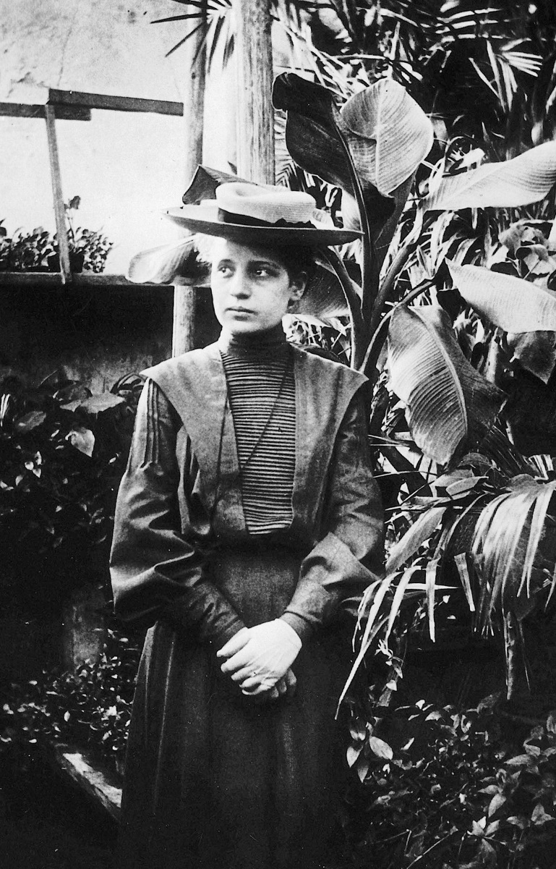
The History
Lise Meitner (1878-1968)
Austrian-Swedish physicist
Experimented with radioactive decay: “transmutation” to new elements
Deduced fission of uranium
Nominated for Nobel Prize in physics and chemistry 49 times
Wikipedia
Notes:
Born to chess master, Lise inherited her father’s free thinking ideals and curiosity. With this, she started researching science and math as a young girl. But at the time, women were not allowed to enter higher education until 1987. She pursued the only thing available to women: teaching. But in 1899 she began taking private lessons with other young women, arming her with what she needed to pass the entrance exam to the University of Vienna in 1901. She completed her thesis in 1905 and was awarded her PhD and began her research, being introduced to radioactivity by a fellow physicist. A mutual acquaintance introduced her to Otto Hahn in 1907, where they began their long working relationship and lifelong friendship.
On the Anschluss, Meitner lost her Austrian citizenship. Through Niels Bohr, she obtained offers from universities in Denmark and Switzerland, but the loss of her citizenship prevented her from entering those two countries. She was then offered a position in Sweden, but it took the effort of colleagues to effectively smuggle her into the Netherlands so she could go there, meeting up with her nephew, physicist Otto Frisch.
Hahn and Strassmann continued their work with uranium, bombarding them with neutrons and studying the resulting isotopes. Alpha decay was newly discovered, so they were not surprised to find radium (z=88 vs. uranium z=92), but something was off. There was barium (z=56, same group as radium). Otto Hahn didn’t understand and thought his chemistry was off. In addition to the barium, he observed the process released a lot of energy!
Discussing with her nephew, Meitner had a thought about a possible new form of radioactive decay. She calculated the masses of the new elements and discovered that they were lighter than the original uranium atoms, by a fraction of a percent of the mass of a proton. Using Einstein’s mass-energy equivalence, she was able to show that this difference in mass, the mass defect, corresponded to the energy released.
The 1944 Nobel Prize in Chemistry was awarded solely to Otto Hahn for the discovery of fission. While there has been many loud cries of foul recently, the proceedings of the committee have since been unsealed and one conclusion is that the various committees did not consider interdisciplinary work, so Meitner’s contributions, seen as physics, not chemistry, were not considered along Hahn’s work. Also, Meitner had a poor relationship with one of the members of the physics committee at the time, and that committee had a bias toward experimental rather than theoretical physics. Otto Frisch later worked on the Manhattan Project, calculating the exact amount of enriched uranium to create the critical mass, the mass that would sustain a chain reaction

Slide 10
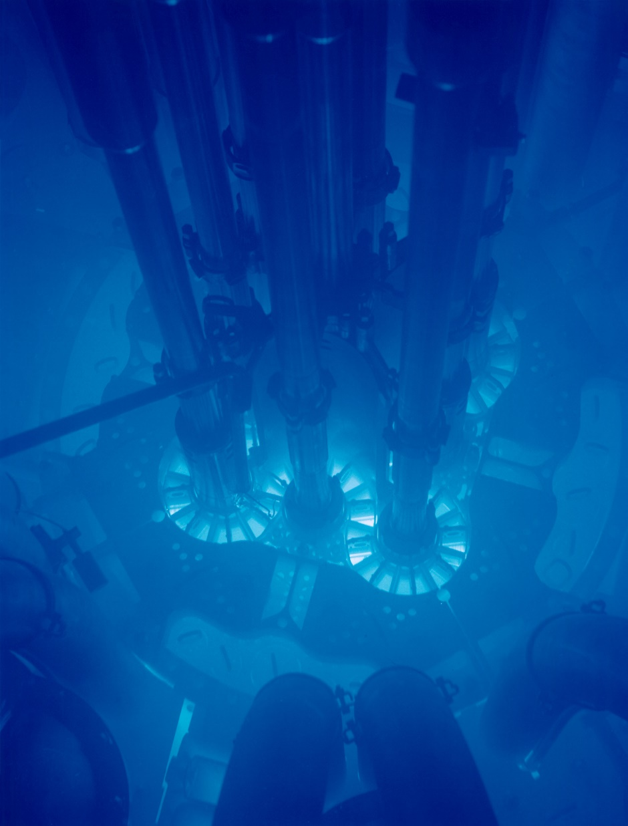
The Power of Fission
Splitting one large nucleus into two smaller nuclei
Small amounts of matter release large amounts of power in the form of heat (kinetic energy) and gamma radiation (photons, γ)
202.5 MeV/fission → 83.14 TJ/kg
~10,000X faster than chemical reactions
Wikipedia
Notes:
The energy released is due to the release of binding energy of the nucleus of the target atom. The total mass of the resulting two (rarely and 4) “fission product daughters” and released neutrons is less than the original atom and impinging neutron.
The energy is in the form of visible light, gamma radiation, and the kinetic energy of the fission product daughters and neutrons rapidly heating up the surrounding environment.
The neutrons are flying away at speeds on the order of 10 to 20% of the speed of light, “fast neutrons,” while the fission products are flying away on the order of 4% of the speed of light.
In this picture, the reactor, submerged in water, is creating the blue glow of Cherenkov radiation. This is caused by charged particles, in this case electrons, moving though a dielectric medium, the water, at a speed greater than “phase speed,” the speed at which a wave propagates through a medium. In water, the speed of light is much less than a vacuum, about 0.75c. This is analogous to a sonic boom produced by an object traveling through the air at a speed greater than the speed of sound.

Slide 11
Fissile vs. Fissionable
Fissionable – Capable of undergoing fission after capturing a high or low energy neutron. Example: U-238
Fissile – Capable of sustaining a fission chain reaction
Implies fission from only low energy (thermal) neutrons
Subset of fissionable
Examples: U-235, Pu-239
U-235 is the only naturally occurring fissile isotope

Slide 12
What is “Critical?”
Critical – Nuclear reaction is self-sustaining, no change in power
Subcritical and supercritical
Critical mass – The smallest amount of fissile material to sustain a nuclear fission chain reaction
Density
Enrichment
Shape
Temperature
Surroundings
Notes:
This term, when it comes to nuclear reactions, is misunderstood by most. People confuse it with the connotation of “critical” being some kind of alarming situation.
In the movie, The Hunt for Red October, the sub’s medical officer, Dr. Yevgeni Petrov played by Tim Curry, with panic in his voice, makes a comment that the reactor is critical. This fuels the misconception.
Criticality is a state where a mass of fissile material is able to sustain a chain reaction with no increase or decrease in power. This is driven by “neutron population.” When the mass is in a critical state, the production of neutrons from the fissions sufficiently make up for losses: Leakage and absorptions not resulting in fissions. One fission yields one neutron that results in one new fission.
Subcritical and supercritical: Where the production of neutrons has too many losses and cannot sustain the reaction. In reactors, this is accomplished with control rods that absorb neutrons before they can induce fission, and where the neutrons from one fission result in more than one subsequent fission, respectively. When subcritical, the reaction will die out, when supercritical, the reaction will increase in power.
Talk about enrichment, U-238 vs U-235. Temperature affects neutron fission “cross section,” the probability of fission given an absorption. Surroundings such as reflectors, moderators, tampers, control rods. Tampers are large masses of material that, through its inertia, delay the thermal expansion of the fission mass, keeping it supercritical longer. Many times the tamper and reflector are the same

Slide 13
Mechanism
Binding Energy
Mass Defect
Mass-Energy Equivalence
Special Relativity, 1905
E = mc²
Example
Mass U-235: 235.043929 amu
Mass 92 p + 143 n: 236.908487 amu
Mass defect: 1.864558 amu (3.0970 X 10⁻²⁷ kg)
The binding energy of the U-235 nucleus
Notes:
The two fission product daughters usually have a mass ratio of 2:3. Rarely there are more than two.

Slide 14
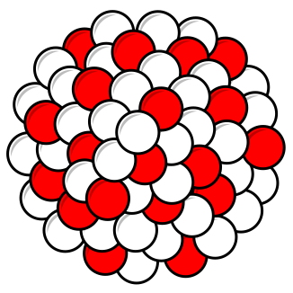
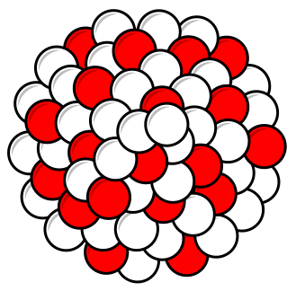
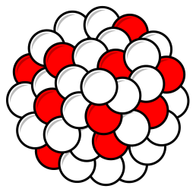
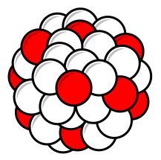

Mechanism
Ba-144
Neutrons
Neutron
U-235 nucleus
U-236 nucleus
UNSTABLE!
Kr-89
Notes:
Click through the animation, explaining each step, especially the absorption of the incoming neutron to produce the highly unstable U-236.

Slide 15
Mechanism
Reactants
Products
Nuclide | Atomic Mass (amu)
Neutron | 1.008 665
U-235 | 235.043 929
Total | 236.052 594
Nuclide | Atomic Mass (amu)
Kr-89 | 88.917 630
Ba-144 | 143.922 952
3 Neutrons | 3.025 995
Total | 235.866 577
This is the key!
Mass Defect: 0.186 017 amu (3.0897 X 10^{–28} kg)
Notes:
The key is the mass defect. The total mass of the products, the two fission product daughters and 3 liberated neutons, has a mass slightly less than the total mass of the reactants, the U-235 nuclide plus incident neutron. This represents the liberated binding energy from the U-235 atom, the electrical repelling force of the 92 protons creeping closer to the total strong force of the 235 nucleons, lessening with the increasing diameter of the nucleus. That one extra neutron pushing it over the edge.
1 amu = 1.6606 X 10^{–27} kg
C = 2.998 X 10⁸ m/s
1 MeV = 1.6022 X 10^{–13} J

Slide 16
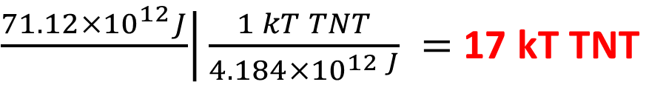
Mechanism
Here’s the math for this one reaction:
Mass Defect: 0.186 017 amu (3.0897 X 10^{–28} kg)
Energy Released: 173.3 MeV (2.777 X 10^{–11} J) per fission
Let’s calculate 1 kg of U-235 with this reaction.
$\left.\frac{2.777×{10}^{−11}J}{fission}\right|\left.\frac{1 fission}{1 atom}\right|\left.\frac{6.022×{10}^{23} atoms}{mole}\right|\left.\frac{mole}{235 g}\right|\frac{1000 g}{kg} =$ 71.12 TJ released
$\left.\frac{71.12×{10}^{12}J}{}\right|\frac{1 kT TNT}{4.184×{10}^{12 J}} =$ 17 kT TNT
Notes:
Uranium is 2.23 times the density of brass, so imagine a mass 45% the size of this brass kilogram weight.
Little Boy, dropped on Hiroshima on August 6, 1945, contained 64 kg of highly enriched uranium, but little of that underwent fission for a yield of about 16 kT, only one kilogram!!
To put this in perspective for power generation, it would take about 710,000 gallons of gasoline, 2,500 tonnes of bituminous/anthracite coal, or 1.8 million cubic meters of natural gas to release this much energy. Or: Typical natural gas home furnace is 100,000 BTU / hr, running for about 100 hours per month → 10 MJ per month → 600,000 years for 17 kT, 1 kg U-235.
1 amu = 1.6606 X 10^{–27} kg
C = 2.998 X 10⁸ m/s
1 MeV = 1.6022 X 10^{–13} J
4.184 X 10¹²J = 1 kT TNT
1 gallon gasoline = 1 X 10⁸ J (0.01 GJ)
Metric tonne coal = 27-30 GJ (bituminous/anthracite)
25.5 m³ natural gas = 1 GJ 1 BTU = 1,055 J or ≈ 1 GJ

Slide 17
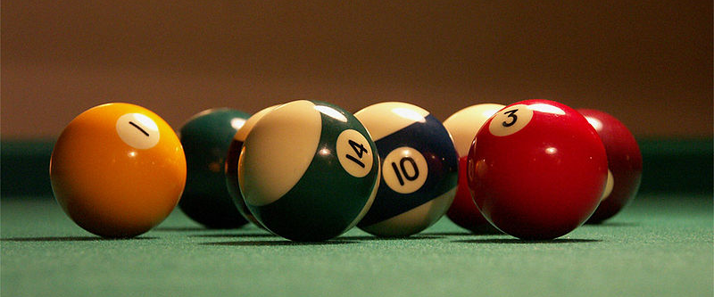
Mechanism
How do we slow down a “fast” neutron to a “thermal” neutron?
Notes:
Neutrons from fissions move on the order of 10-20% of the speed of light, too fast to be captured by a U-235 nucleus. Their energy needs to be reduced to almost not moving. Elastic collisions. Water is great because of the hydrogen: a proton. Just like balls on a pool table.
The first neutrons come from a “neutron source.” Typically a heavy element such as Americium that undergoes α decay with those beams hitting a lighter element, such as beryllium, to liberate a neutron. Subsequent startups use neutrons from the very few fissions that occur during shutdown. Important to note that the control rods being fully inserted can never reduce the fissions to zero.

Slide 18
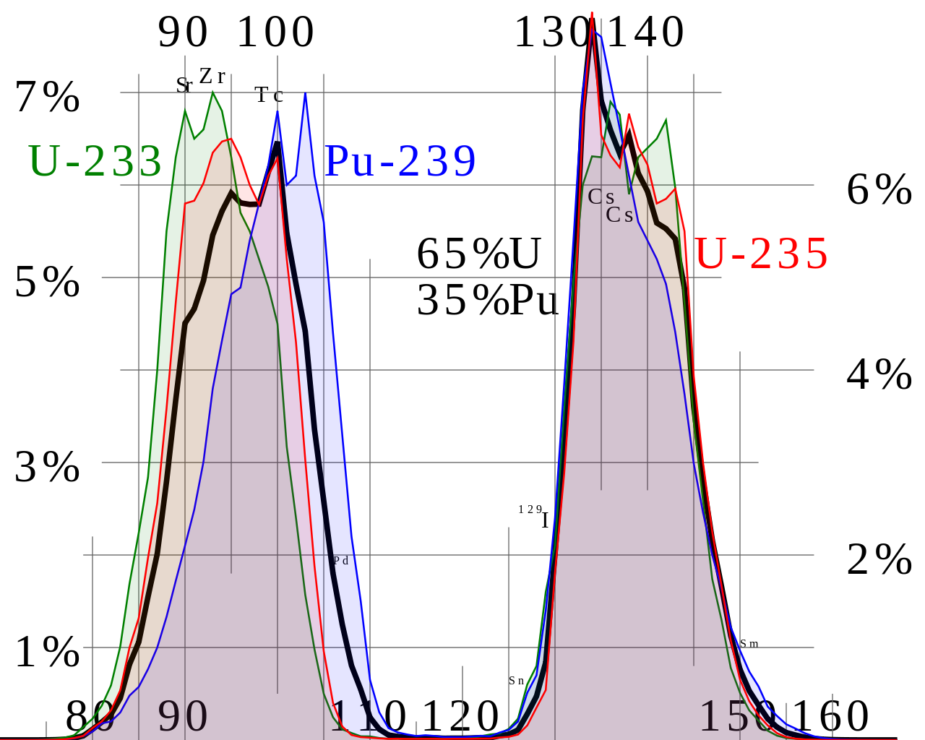
Mechanism
Notes:
Thermal fission yield curve, relative occurrence of what fission product daughters. U-235 in red. Again, the two fission product daughters typically have a mass ratio of 2:3. Also important to know that highly enriched U-235 pressurized water reactors, these fission product daughters are radioactive, undergoing α and β– decay, producing heat. At 100% rated power, 7% of the power (heat) comes from “decay heat,” meaning that when you shut down the fission reactions with the control rods, the reactor will still be producing 7% power so it requires decay heat removal for a few weeks and constant monitoring thereafter.

Slide 19
Questions

Slide 20
Objectives
Define the following terms:
Fission – Fissile – Mass defect – Binding energy
Criticality – Critical mass – Moderator
Discuss the history of some key events leading to the fission of U-238
Describe the mechanism of U-235 fission
Contrast fast and thermal neutrons and the role of the moderator
Discuss the effect of decay heat on reactor power and temperature

Slide 21
Assessment
What is the difference between fissionable and fissile?
Fissionable isotopes are capable of undergoing fission after absorbing a neutron, such as U-238.
Fissile isotopes are capable of sustaining a chain reaction, such as U-235 and Pu-239.
What is critical mass? List some things that affect it.
The smallest amount of fissile material to sustain a nuclear fission chain reaction. The amount is affected by:
– Density – Enrichment – Shape
– Temperature – Surroundings

Slide 22
References
Atomic Archive, www.atomicarchive.com
Metals and Alloys – Densities, The Engineering Toolbox, https://www.engineeringtoolbox.com/metal-alloys-densities-d_50.html
Nuclear Physics and Reactor Theory, Navy Nuclear Power School, 1993
United States Department of Energy, www.energy.gov
United States Nuclear Regulatory Commission, www.nrc.gov/
Wikipedia, wikipedia.org

